Slide 1
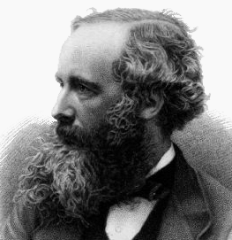


CHEM 450/450G
Dr. M. J. Nee
Lecture II-1A
Spontaneity: Gibbs and Helmoltz Energies
Plan for Today:
Gibbs Energy
Helmholtz Energy
Differential Forms
T, P dependence
Chemical Potential

Slide 2
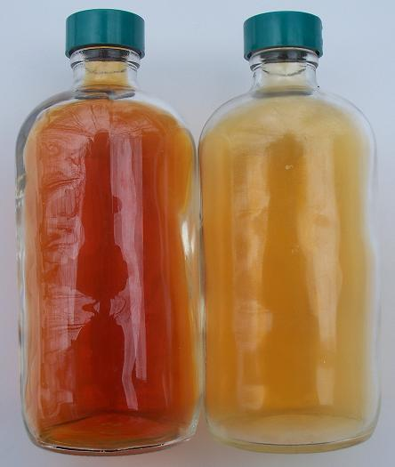
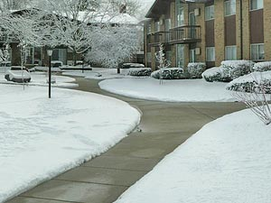
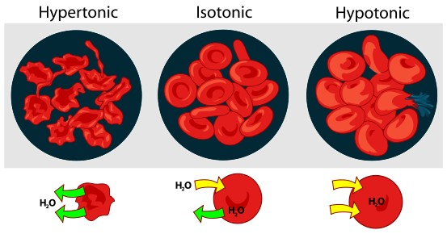
Spontaneity, Equilibrium, and Solutions

Slide 3
Conditions for spontaneity
For an isolated system, spontaneous processes have ΔS > 0. The process continues to be spontaneous until ΔS = 0.
For a system in contact with surroundings:
But this is often inconvenient – it would be easier if we could deal with things in terms of the system only.

Slide 4
Spontaneity in a chemical reaction
Exothermic: heat flows from system to surroundings
q < 0
More moles of gas products than reactants
ΔS > 0

Slide 5
Reminder: Clausius Inequality
For any process,
Where equality holds only for reversible processes.
Review the first law (expanded beyond P-V work) to replace dq, rearrange and get

Slide 6
Nonexpansion work: Helmholtz energy
We define a new state function, the Helmholtz energy (A), such that
A useful relationship to work for isothermal processes:

Slide 7
Helmholtz Energy at constant volume
For constant volume,
And, unless there is non-expansion work,
Since this was derived from the Clausius inequality, this is a new criterion for spontaneity under certain conditions (constant T and V)

Slide 8
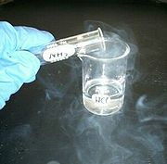
Constant Pressure: Gibbs Energy
We define another state function, the Gibbs energy (G), such that
Now, our criterion for spontaneity is as follows:
G
ξ

Slide 9
Changes in Gibbs Energy
But for what conditions does this hold? What assumptions have we made about our system and process? How valid are they? Are they sometimes more valid than others?

Slide 10
Gibbs Energy for a reaction
This works just like enthalpy and entropy:
OR, you can use the relationship between ΔH and ΔS
Surprisingly, the temperature dependence of ΔG is not quite as simple as it is for ΔH and ΔS

Slide 11
Differential forms
From which we can derive all of the following puzzle pieces, now with only expansion work

Slide 12

Maxwell relations
A particularly convenient (and experimentally grounded) set of equations are the Maxwell relations. Maxwell liked to do math. He pretty much went around cleaning up people’s messes.

Slide 13
P-dependence of Gibbs energy
We have already shown that
Away from standard pressure (1 bar):
But for a liquid or solid:

Slide 14
T-dependence of Gibbs Energy
At constant pressure, we can determine the temperature dependence of G/T, which will prove more useful than determining the T-dependence of just G:

Slide 15
Gibbs-Helmholtz equation
For a more useful approach, we integrate over macroscopic changes in Gibbs energy:
From which we derive a relationship between enthalpy and Gibbs energy at different values of T:

Slide 16
The meaning of G-H equation
No T-dependence on enthalpy term
If we know ΔG and ΔH at one temperature, we can calculate it at any temperature
Note no long term as before for ΔH – Largely a result of ΔG/T dependence on T.
In other words, YOU CANNOT USE
to determine temperature dependence of G!

Slide 17
Multiple components
One of the simplest chemical systems we can begin with are mixtures of gases. Why start with gases?
Consider the system below:
After some time, equilibrium will be reached. How will we know when this has happened?

Slide 18
Chemical potential
For a mixture of several components, we can write the differential for Gibbs Energy in terms of components (n₁ and n₂)
where we define the chemical potential for each component as the partial molar Gibbs energy:

Slide 19
Mixtures of gases at equilibrium
When a gas mixture reaches equilibrium of mixing, then, for every component, i, the chemical potential (μ_{i}) is 0:
Note that the partial pressure on either side of the barrier may not be the same, but the chemical potential on either side will be!

Slide 20
Gibbs energy for any reaction mixture
For a mixture at effectively constant composition, we can treat μ as independent of n!
So that
What does this mean?

Slide 21
Reading: This material is contained in the first few sections of chapter 6. We introduced chemical potential and mixing here, which we will expand upon next time (the middle of chapter 6).

